Slide 1
3D Visualisation of Sensor Information on Google Android platform
Overview and Interface prototype

Slide 2
What will I talk about?
What is Google Android?
The high-level aim of my project and some details.
Interface mock-ups.
Challenges (i.e. things I don’t know... yet!)

Slide 3
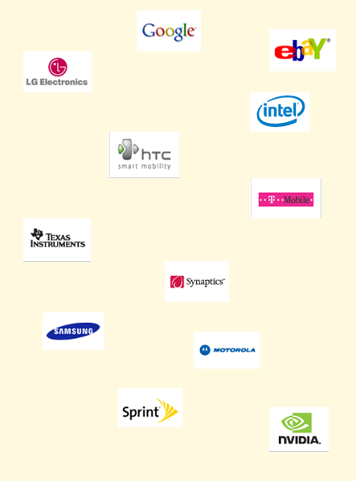
Android and Open Handset Alliance
Android is an open-source mobile operating system.
Developed by Google in partnership with biggest industry players.
First phone featuring it, T-Mobile G1 was developed by HTC and released in October 2008.
Many people see it as only real competition for the iPhone, although OHA still have a way to go.
More phones to come.

Slide 4
Android & Development
Google launched Android Market to enable developers to distribute their applications. Idea similar to the iTunes Store, but with fewer restrictions (so they say).
SDK for Android is freely available for anybody who wants to write applications using it and the OS itself is open-source.
Android runs each a version of Linux – Dalvik.
Features OpenGL ES 1.0, enabling 3D applications – good for me!

Slide 5
My project
On the highest level: to develop a front-end application to enable real-time (almost) monitoring of a building.
In more details:
Interpret data collected by the sensors inside the building and stored as an OWL (XML) file.
Map the interpreted readings onto a 3D model of the building to present status of each room (temperature, light, occupancy, door/window locks etc.)
Enable the user to set an actuator value (like temperature) and save the changes in a repository, from which the actuators would be controlled.

Slide 6
A bit of project management...
Chosen software development methodology:
iterative waterfall with a bit of sashimi :)
Tasks:
- Exploration – done
- Requirements Analysis – done
- Architectural and Interface Design – almost done
- Development – can’t wait!
- Testing...

Slide 7
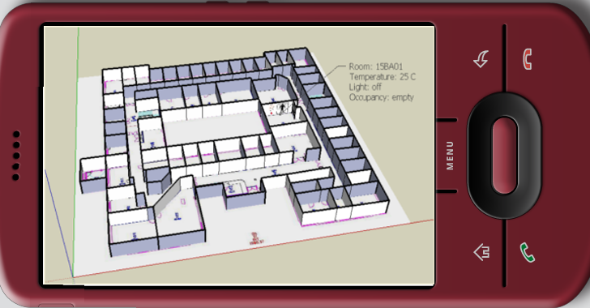
Interface

Slide 8
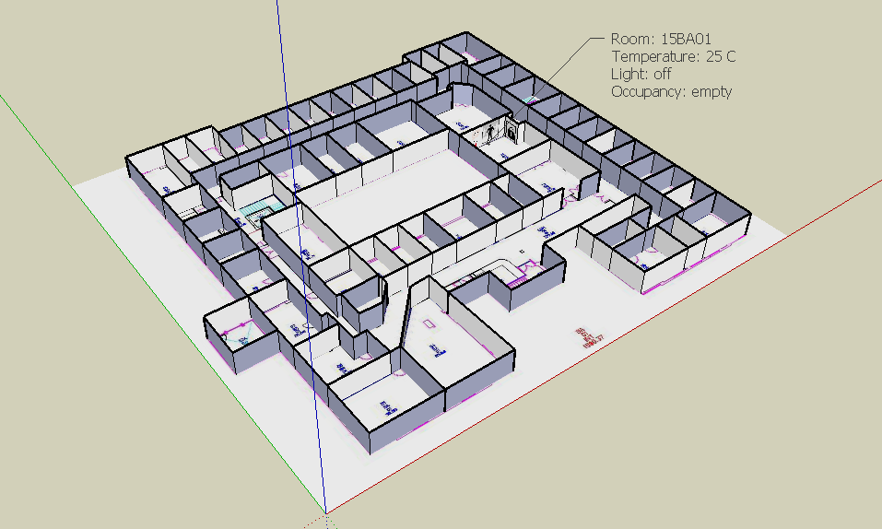
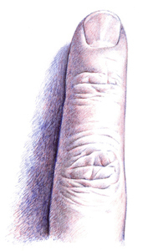
Interface

Slide 9
Interface

Slide 10
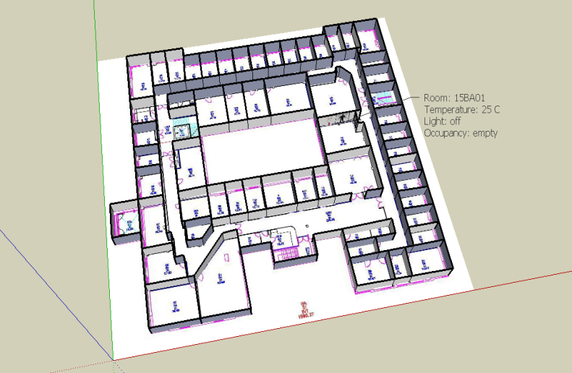
Interface

Slide 11
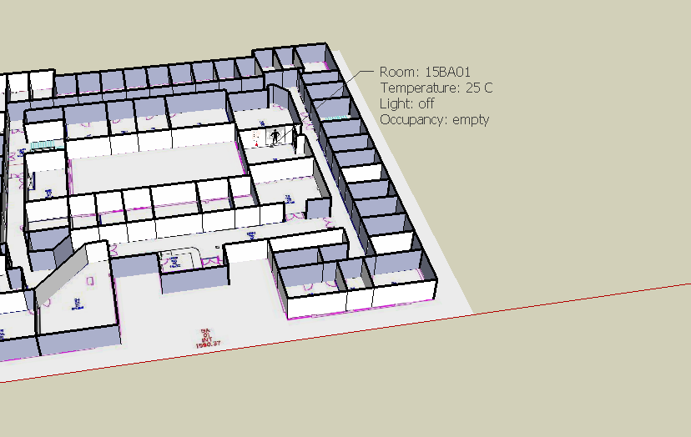
Interface

Slide 12
Challenges
Interpreting OWL data on Android
Jena API (which I was planning to use) does not seem to be easily portable
alternatives: different APIs or process data externally and send to the device in SQL format (which is supported) – last resort
Importing a 3D model into Android
Need to build a model (using 3DS Max, Blender, Sketch-Up etc.) - easy
Maybe convert it to COLLADA format – easy
Write/get a Java loader - hard
Hope it will work with Android’s version of OpenGL ;)

Slide 13
Any questions?

Slide 14
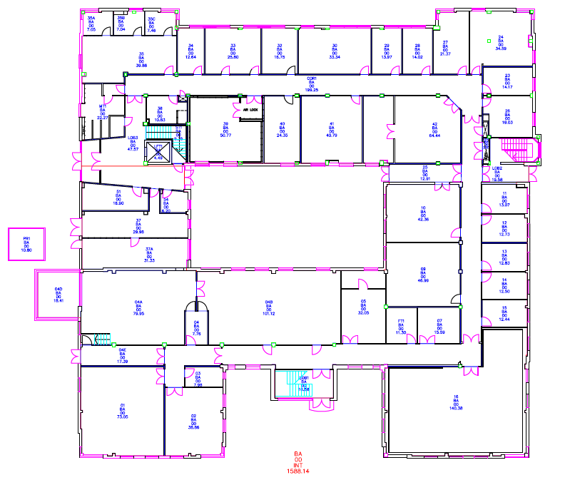
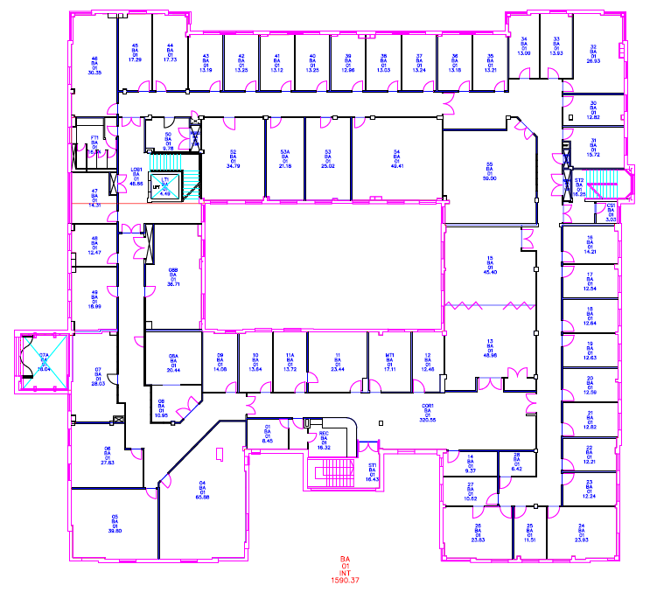
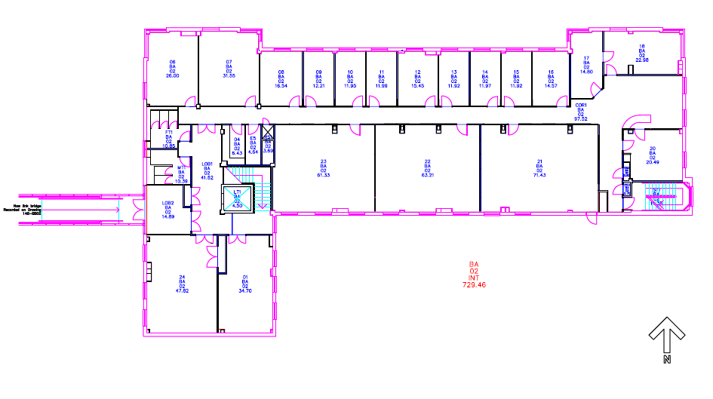
Additional material

Slide 15
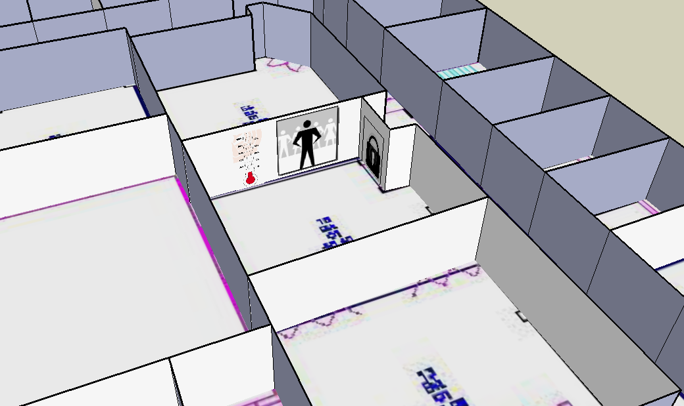
Additional material

